Slide 1

MITRE/JPL Workshop
JPL Quantum Capability for USSF
Jason Hyon, John Callas, Sheng-Wey Chiow, Darmin Arumugam, Nan Yu, Alex Lohrmann, Siamak Forouhar, Matt Shaw
2024
This document has been reviewed and determined not to contain export controlled CUI.

Slide 2
Assessment Of Quantum Technology
While quantum technology promises significant advancements in sensing and form factors, there is currently no clear strategy for its implementation. To harness these breakthroughs from governments, industry, and universities effectively, NASA needs to create opportunities for their infusion. This process should be guided by the scientific community to ensure proper prioritization and relevance. Rather than focusing on entirely new measurements enabled by quantum technology—which may not yet be clearly defined—the emphasis should be on improving the affordability and efficiency of concurrent measurements of multiple species. This is similar to how semiconductor technology transformed large, cumbersome computers into powerful, compact laptops and cloud services.
Imagine a sensor which can provide both radar and lidar measurements concurrently on a single smallsat platform

Slide 3
NASA: Quantum Gravity Gradiometer Pathfinder
Description: Quantum gravity gradiometers (QGGs) perform remote-sensing of gravity gradients using light-pulse interferometry with laser-cooled atoms – A joint team of JPL, GSFC, US Industry, UT Austin
Details
Current TRL:
  Overall concept: ~TRL3, technology elements demonstrated in labs
  Subsystems:
    Atomic Physics Package ~TRL3
    Laser Optics System > TRL4, space qualified laser system available
    Integrated Control Electronics > TRL4, standard engineering
Organizations Involved:
  JPL, POC: Jason Hyon, Project Lead; Brian Muirhead, Project Manager
  GSFC, POC: Tim Beach
  UTA, POC: Srinivas Bettadpur
Underlying/Enabling Technologies:
  Long-interrogation-time atom interferometers using ultracold atoms
  Forward and inverse modeling of Earth gravity using QGG
Cost & Schedule
Planned Milestones:
  FY24: Instrument architecture and design studies
  FY25: Instrument architecture review
  FY26: Preliminary Design Review (PDR)
  FY29: Flight payload system completed
Period of Performance:
  FY24-FY25: Tech maturation
  FY26-FY28: Payload development
Cost and Schedule Risks:
  Launch and hosting of payload have not been determined
Activities & Approach
Technical Interchange Meetings held between NASA and Airbus/DLR on mutual interest of QGG for mass change studies
Established science benefits based on the pathfinder payload and science grade instrument
Identified technology roadmap for science grade instrument QGG
Established value propositions of a pathfinder mission
Established level of learning in a pathfinder mission
Established validation approaches
Established pathfinder payload definition
Established a reference design for QGG pathfinder payload
Technology maturation and risk reduction activities in FY24-FY25
Engaging with vendors on industry participation
Evaluating potential host platforms
Payload development starting in FY26
Impact
How does this project improve the SoA and meet Mission/Agency needs?
  QGGs are envisioned to provide enhanced global gravity maps to further climate studies, map changes in the terrestrial water and monitor ice sheet melting. The QGG pathfinder mission will fly the first QGG in space with the following main objectives: end-to-end QGG system demonstration, functional validation of gravity remote sensing, scalability to longer atom-interferometer interrogation times relative to ground-based systems, precision control of atomic test masses in microgravity, and validation of critical hardware and key subsystems.
Planned/Potential application(s):
  Earth sciences including DoD applications; planetary sciences; fundamental physics, dark matter, dark energy and gravity physics
Does this enable other quantum technologies?
Atomic quantum remote sensors; optical clocks

Slide 4
NASA: Quantum Gravity Gradiometer Pathfinder
How could S&T Partnership collaboration benefit this effort?
Potential cost sharing on platform and launch
Develop applications of QGG for USSF and NRO
Cross-sharing of relevant quantum sensor expertise (e.g., via reviews)
How does a collaboration here benefit the S&T Partnership?
Establish US leadership of Quantum sensing technology in competition with international agencies, especially with China
Quantum remote sensing technology maturation
Accelerates demonstration of SOA quantum remote sensing
Develops common technology and subsystems usable across a range of cold atom interferometry sensors and instruments
CY24 Technical Milestone and 3-5 Year Demonstration
Major tasks required (2024):
US industry engagement (prototypes)
Technology maturation activities (testbeds)
Host platform identification
Project implementation plan to NASA ESTO
Technologies/facilities needed to advance project to a demo:
  A ground-based, microgravity facility (e.g., drop tower) would significantly benefit ground testing and validation.
Time required to get to a demo:
  Approximately four years to complete payload development
Level of investment required to reach a demo:
  LEO host platform and launch opportunity

Slide 5
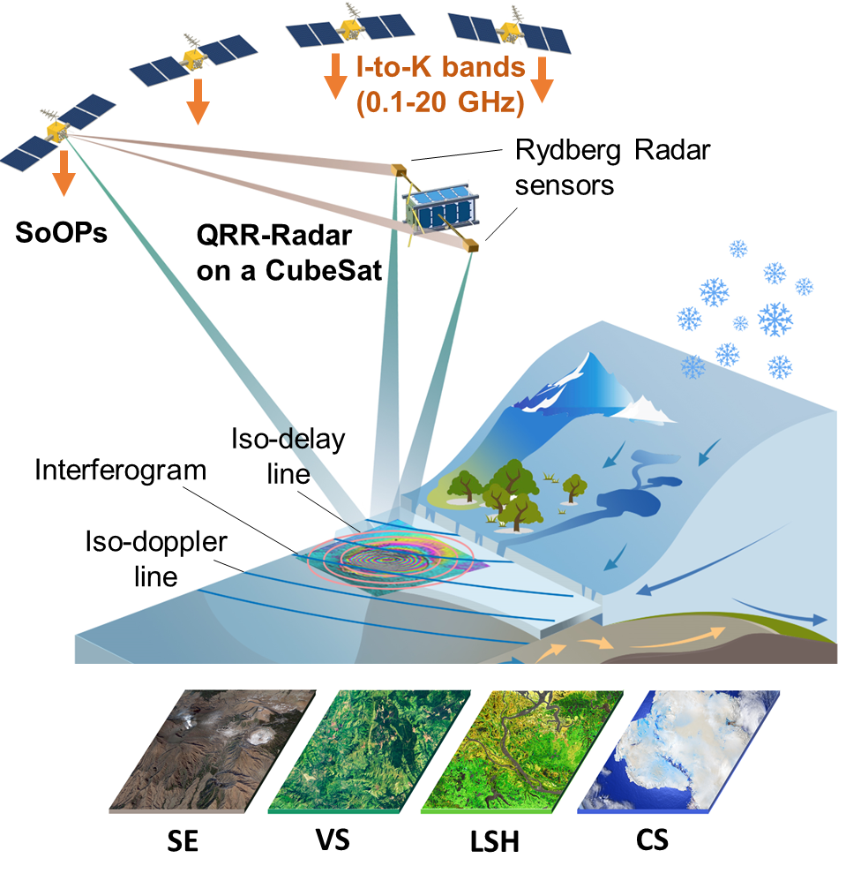
NASA: Quantum Rydberg Radar
Description: Rydberg Radars enable broad-spectrum remote-sensing of the earth system using signals of opportunity
      Bi-static reflectometry with delay doppler mapping using Rydberg atom sensors
      Uses over 3000 transmitters from I-K bands from communications, navigations, and military satellites
Details
Current TRL:
  Overall concept: ~TRL3, key technology elements demonstrated in labs
  Subsystems:
    RF Focusing/Reflector System ~ TRL3, reflectors, lens, resonators used in lab
    Atomic Physics Package ~TRL3, laboratory systems routinely used
    Laser Optics System > TRL4, space qualified systems available
    Integrated Control Electronics > TRL4, space qualified systems available
Organizations Involved:
  JPL, POC: Darmindra Arumugam, Project Lead & Lead Technologist
  NIST, POC: Christopher Holloway
  ARL, POC: Paul Kunz
Underlying/Enabling Technologies:
  Rydberg atom-based sensing of RF fields
  Synthetic aperture imaging based on bi-static reflectometry
Cost & Schedule
Planned Key Milestones:
  FY23: ground experiments of radio reflectometry (JPL SRTD)
  FY24: low-altitude airborne experiment of along-track integration (NASA NIAC Phase 2)
  FY25: high-altitude airborne demonstrations
  FY26: design reviews for an experiment (tech demo) in space
  FY27: breadboard payload system completed
  FY28: tech demo payload system completed
Period of Performance:
  FY23-FY25: tech maturation
  FY26-FY28: tech demo payload development
Cost and Schedule Risks:
  Support, logistics, funding not yet secured for tech demo payload development
Activities & Approach
Technical Interchange Meetings held between NASA, NIST, and ARL on Rydberg architectures
Developing science value for NASA STV (surface, topography, and vegetation) in the 2030’s
Identified technology roadmap for science grade experiment in space and in a high-altitude platform
Established quickest path to a low altitude and high-altitude experiment. Completed plan for low altitude.
Established validation approaches for ground experiments
Technology maturation and risk reduction activities in FY23-FY25 with high altitude demo in FY25
Engaging with vendors on industry participation
Impact
How does this project improve the SoA and meet Mission/Agency needs?
  QRR is a disruptive architecture enabling high sensitivity, dynamic and rapidly tunable radar remote sensing throughout the entire radio window. QRR enables measurement of key Earth Science variables spanning numerous science applications in a (1) post-launch dynamic/rapid on-the-fly tunable, (2) with low power, (3) small-sat instrument, (4) and no arraying of antennas required to cover various bands. For Earth Science is can address needs in Cryospheric, Solid Earth, Hydrology, and Vegetation structure. The approach can also be applied to airborne instruments and drones and has value in remote signal intelligence for DoD and DHS applications.
Planned/Potential application(s):
  Primary focus is Earth Sciences for STV. Ongoing efforts to advance mobile and airborne systems for DoD/DHS tracking and remote signal intelligence applications.
Does this enable other quantum technologies?
Atomic radiometers and other remote sensing techniques

Slide 6
NASA: Quantum Rydberg Radar
How could S&T Partnership collaboration benefit this effort?
Potential cost sharing on tech demo in space in FY25-28
Advance remote signal intelligence and tracking applications for USSF and NRO (broad-spectrum, on-the-fly tunable radar and radiometer remote sensing)
Cross-sharing of relevant quantum sensor and remote sensing expertise to advance algorithms for this tunable technique
How does a collaboration here benefit the S&T Partnership?
Establish US leadership in Quantum remote sensing in competition with international agencies, especially with China
Support to further integrate efforts between the various US labs and accelerates maturation of Rydberg remote sensing
Accelerates demonstration of SOA Rydberg remote sensing (example Rydberg sub/super cell arraying)
Push to develop common technology and subsystems usable across a range of Rydberg remote sensing application needs
CY24 Technical Milestone and 3-5 Year Demonstration
Major tasks required (2024):
Development of low-altitude airborne experiment and systems
System testing and validation in a low-altitude tethered system
Demonstration of multi-band radar along-track integration in a low-altitude tethered system
US industry engagement (component design and development kick-off)
Ground-based technology maturation activities (testbeds)
Planning and design for high-altitude airborne experiments
Technologies/facilities needed to advance project to a demo:
  Ground-based and tower-based testbed
  Low-altitude tethered testbed
  High altitude experiment through a balloon/aircraft

Slide 7
NASA: Optical/Atomic/Ion Clock
Description: Space clocks supporting deep space mission and science based on JPL DSAC and micro mercury ion clock, funded by ONR. More advanced miniature space ion clock is in development that promises to have >10x performance over DSAC in both short and long term stabilities but in a smaller size (miniaturized from 500cc to 10 cc). An optical clock would improve performance dramatically further, allowing 1 part in 10¹⁸ accuracy
Details
Space clocks supporting deep space mission and science measurements – deep space navigation and communication reply on precision frequency references afforded by atomic clocks. JPL Deep Space Atomic Clock (DSAC) has been already demonstrated by the NASA first TDM intended to enable one-way navigation to maximize the ground DSN access efficiency.
Current TRL:
  TRL is at 4, with portable optical clock systems demonstrated in several labs
  TRL is at 7 for Micro Mercury ion clock (M2TIC) developed by JPL. Frequency Electronics will deliver clocks to ONR.
Organizations Involved:
  JPL: Nan Yu (POC), GSFC: Holly Leopardi (POC); NIST: Chris Oates, Nate Newbury; ONR
Underlying/Enabling Technologies:
  Cold atoms; optical traps; ultra-stabilized lasers; frequency combs
Cost & Schedule
Planned Milestones:
  M2TIC: PDR 2023, CDR 2025
  Lab optical clock demo (not a flight prototype) in 2024
  FY26: System Requirements Review (SRR); Preliminary Design Review (PDR)
  FY28: Critical Design Review (CDR); Breadboard payload system completed
  FY30: Flight payload system completed
Period of Performance:
  FY23-FY25: tech maturation
  FY26-FY30: payload development
Cost and Schedule Risks:
  Technology maturation
Activities & Approach
Established optical clock testbed lab
Science community workshops
Science Definition Team has studied potential science missions
Awaiting Decadal Survey results to finalize mission over-all design
Engaging with vendors on industry participation
Payload development starting
In FY25
Impact
How does this project improve the SoA and meet Mission/Agency needs?
  Space-based optical clocks are expected to revolutionize timekeeping, providing a world-wide master clock of unprecedented accuracy (current ground clocks are limited by uncertainties in local gravity)
Planned/Potential application(s):
  World timekeeping (establishing a space-based master clock)
  Precise Navigation, and relativistic geodesy
  Fundamental physics; tests of quantum gravity, gravitational wave detection, dark matter searches
Does this enable other quantum technologies?
  Laser systems, cold atom technologies, and frequency combs have broad utility in a variety of quantum sensing applications

Slide 8
NASA: Optical Clock
How could S&T Partnership collaboration benefit this effort?
Potential cost sharing on platform and launch. Explore applications of clocks for USSF and NRO
How does a collaboration here benefit the S&T Partnership?
Optical clocks have broad benefit to science, DoD applications, and society as a whole. This mission will continue US leadership in this area. A collaboration will accelerate demonstrations and allow development of common technology and subsystems
CY24 Technical Milestone and 3-5 Year Demonstration
Major tasks required:
Technology maturation activities (testbeds)
Host platform identification
Prototype development
Ideally we would also demonstrate clock technology in space prior to deployment of a full clock
Technologies/facilities needed to advance project to a demo:
Increased investment in technology development and testbeds
Time required to get to a demo:
  Lab prototype of Space Instrument 2 years
  Meaningful space demonstration 4 years
  Demonstration of full clock 6 years
  FOCOS type mission. 8-12 years

Slide 9
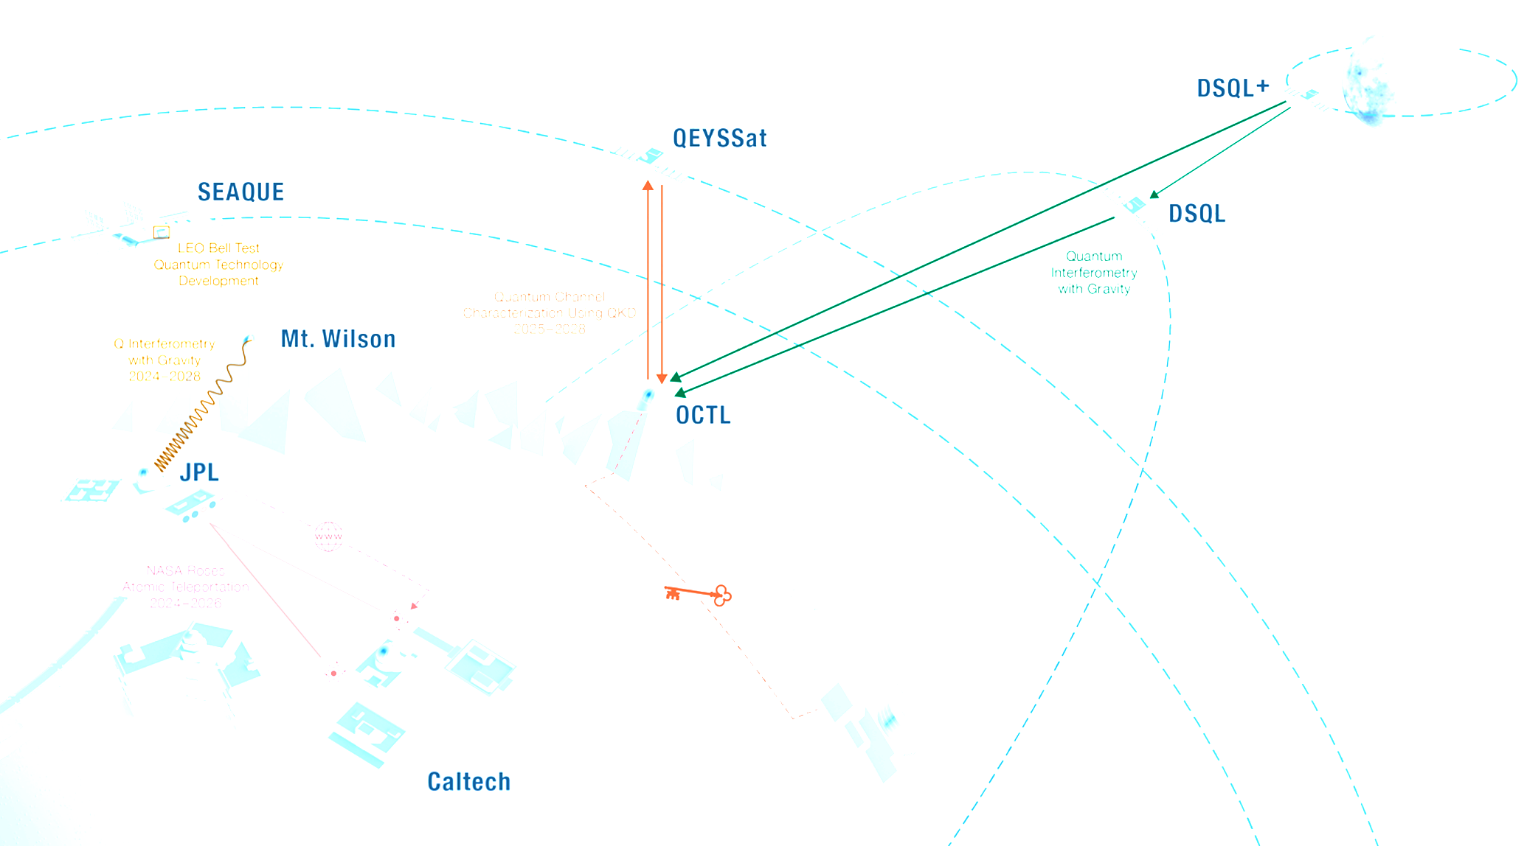
NASA: Quantum Communication
Description: Quantum communication links in space enable a wide range of novel science experiments, and are a key component of future global quantum networks. Quantum optical interferometry across gravitational potential differences will demonstrate first tests of quantum field theory in curved space time by measuring gravitational redshifts of quantum states. Quantum communication will enable global secure communication, as well as connecting future quantum sensors and computers. Terrestrial proof-of-concept demonstrations are implemented to justify future space missions.
Details
Several mission concepts are investigated using theoretical analysis and terrestrial proof-of-concept demonstrations.
Current TRL at NASA-JPL (global state-of-the-art):
  Quantum interferometry: TRL 3-4 (3-4, Chinese free-space demonstration)
  Quantum key distribution: TRL 3-4 (9, for example Chinese Micius mission)
  Quantum communication: TRL 3-4 (4-5, Urban scale quantum communication)
Organizations Involved:
  JPL: Alex Lohrmann, UIUC: Paul Kwiat, Caltech: Andrei Faraon
Underlying/Enabling Technologies:
  Quantum light sources: Entangled-photon sources, single-photon sources
  Solid-state qubits: Quantum sensors, clocks, computational qubits
  Quantum channels: Free-space optical (FSO) links (space and ground systems)
  Quantum measurements: Single-photon detectors, quantum-state control, synchronization, precision interferometry
Cost & Schedule
Current & Planned level of investment at your organization:
  FY24: $\sim$$1M; FY25-FY26: $\sim$$2.2M
Planned Milestones:
  FY24: Launch of SEAQUE mission (DSQL)
  FY25-26: Terrestrial gravitational redshift measurements (DSQL)
  FY26: Remote entanglement of solid-state qubits over FSO links (NASA ROSES)
  FY27-28: Quantum uplinks to Canadian QEYSSat spacecraft
  FY27-29: Quantum communication mission development
Period of Performance:
  FY24-FY26: Technology demonstrations and terrestrial experiments
  FY27-FY29: Mission development
Cost and Schedule Risks:
  Risk that other nations (China) will execute similar space missions sooner
  Space mission and ground station implementation currently not funded
Activities & Approach
International Science Definition Team investigated novel quantum optical experiments in space (NASA BPS support)
National collaboration developed agenda for future quantum communication missions (NASA SCaN support)
Impact
How does this project improve the SoA and meet Mission/Agency needs?
  The novel quantum interferometry concept will open up new research avenues of tests of theories at the intersection of quantum mechanics and general relativity
  The technology developed during this project will lay the foundation for future quantum communication missions by maturing key technologies
Planned/Potential application(s):
  Global secure communications
  Time transfer using quantum states
  Quantum LiDAR, quantum telescopes
Does this enable other quantum technologies?
  Magnetic/gravitational field sensing improvement in entangled sensor networks
  Quantum gyroscopes
  Blind/distributed quantum computing
SEAQUE
QEYSSat
Technology roadmap development
Mission architecture development using orbital models, optical link budgets and experiment simulations
Space technology demonstrations (SEAQUE)
Quantum ground station design
Development of terrestrial proof-of-concept experiments (FY25-27)
DSQL
OCTL
JPL
Caltech

Slide 10
NASA: Quantum Communication
How could S&T Partnership collaboration benefit this effort?
Cost sharing for application-focused terrestrial implementations (e.g. quantum LiDAR, time transfer)
Cost sharing of ground station development (e.g., shared designs)
Sharing of relevant expertise (e.g., reviews/technology/concepts)
Partners for national quantum communication demonstrations (e.g. secure communications via the QEYSSat spacecraft)
Shared applications for funding support for quantum communication missions
How does a collaboration here benefit the S&T Partnership?
Effort to close the technology gap between the US and other nations, most importantly China
Implementation of a collaborative space mission will vastly increase the scope of future quantum communication missions that are currently not feasible
Technology maturation in this field may enable applications outside of quantum sensing, e.g. optical communication and sensing
CY24 Technical Milestone and 3-5 Year Demonstration
Major tasks required (2024):
Mission trade studies: Produce overview of different mission concepts with ROM timelines and budget estimates
Mission concept: Select a mission concept of mutual interest to all parties
Roadmap development: Define a technology maturation and project roadmap
Technologies/facilities needed to advance project to a demo:
  Quantum optical ground station
  High-gain optical communication links (LEO to ground)
  Timing synchronization (optical phase stability)
Time required to get to a demo:
  If funded, 3-5 years from project start to on orbit demonstration
  2 years from project start for ground systems development and terrestrial demonstrations
Level of investment required to reach a demo:
  $20-40M

Slide 11
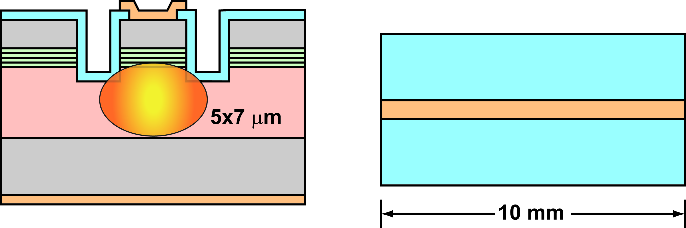
NASA: Semiconductor Lasers and Amplifiers for Space
Description: This effort is to develop and mature critical Laser Optical System (LOS) for cold-atom quantum sensors with focus on high resolution gravity measurement
Details
Semiconductor lasers and semiconductor optical amplifiers in the 500-900 nm wavelength range play a crucial role in quantum sensing technologies. The laser optical system for cooling, transport, and interferometry of neutral cold atoms (e.g. Cs or Rb) requires performance and form factor beyond state-of-the-art. The performance in terms of linewidth, wavelength stability, optical phase noise, tuning speed, power consumption, and reliability do not meet the requirements of space borne instruments. We are developing and maturing critical photonic components and implement system level integration of a robust flyable Laser Optical System (LOS) for cold-atom quantum sensors.
Current TRL: TRL 3:
The concept of semiconductor laser and amplifiers has been successfully demonstrated and tested in a laboratory environment. Efforts are underway to develop improved and repeatable fabrication and packaging techniques followed by space qualifications.
Organizations Involved: JPL, MIT-LL, Industry
Underlying/Enabling Technologies: Advanced semiconductor growth technologies such molecular beam epitaxy (MBE), Advanced semiconductor fabrication and characterization techniques
Cost & Schedule
Planned Milestones:
  FY25, Fabrication and evaluation of Corrugation Pitch Modulation (CPM) DFB lasers
  FY25: Evaluation of external cavity GaAs-SiN lasers
  FY25: Demonstration of better than 20 dB gain and 100 mW output power from SOA
  FY26-27 Demonstration of packaged SOAs better than 100 mW output power and lasers with less than 5KHz linewidth
Period of Performance:
  FY25-27: technology maturation
  FY28-30: incorporation into relevant payload
Cost and Schedule Risks:
  Low risk. Some delay may be caused due to receiving epitaxial structures from foundries,
Activities & Approach
narrow-linewidth laser fabrication at JPL’s Microdevices Laboratory
Impact
How does this project improve the SoA and meet Mission/Agency needs?
High-resolution gravity measurement is relevant to:
Understanding hydrologic cycle and water storage
Measuring water and sea ice distribution
Geophysical processes and disaster preparedness (e.g. earthquake forecasting)
Natural resource detection
Current state-of-the-art gravity measurements are done via satellite-satellite tracking. Cold-atom interferometry is a novel technique for gravimetry that uses clouds of ultracold atoms in free fall as ideal inertial test masses. The sensitivity of AI measurements is enhanced by orders of magnitude in microgravity opening the door to beyond-state-of-the-art measurement precision in a single-satellite deployment.
Does this enable other quantum technologies?
Advances in optical component technology will directly benefit an array of quantum systems based on cold atoms, quantum communication.
Semiconductor Optical Amplifiers
Collaboration with MIT-LL

Slide 12
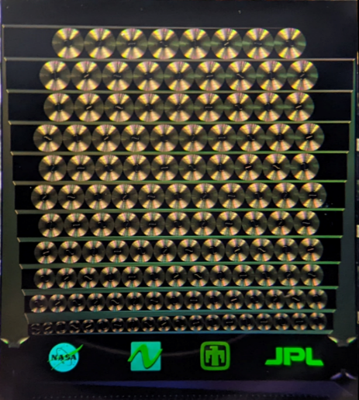
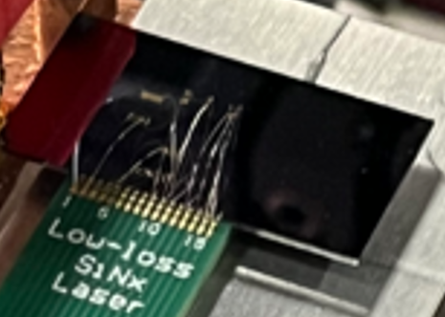
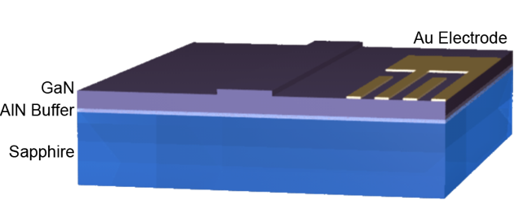
NASA: Integrated Photonics for Space
Description: JPL is developing high-performance active integrated photonics for space-based sensors that require novel functionalities, non-standard wavelengths, and reliable operation in harsh environments.
Details
Functional integrated photonic devices to enable high-performance optical sensors, including cold-atom-based instruments, RF-photonics, interferometry, etc. Efforts include both component-level advances to support flight optical systems (ultranarrow linewidth external cavity lasers, ultralow power acousto-optic modulators) and instrument-level functionality such as optical and RF spectrometry, high-extinction-ratio interferometric sensing, etc.
Current TRL: ~TRL3, technology elements demonstrated in laboratory environment, maturation efforts are ongoing
Organizations Involved: JPL, Sandia, MIT-LL, Yale, Phase Sensitive Innovations
Underlying/Enabling Technologies: Active integrated photonics, semiconductor lasers/amplifiers, piezo-optic circuits, RF-photonics
Cost & Schedule
Planned Milestones:
  FY25: Packaging of components and reliability testing
  FY26-27: Implementation in relevant experiments for performance validation, radiation and thermal test
Period of Performance:
  FY25-27: technology maturation
  FY28-30: incorporation into relevant payload
Cost and Schedule Risks:
  Tech development may lead to delays, this has been budgeted for in notional timeline
RF-photonic AWG chip
Integrated ECDL
Activities & Approach
Development of an active GaN-on-Sapphire integrated photonics platform offering scalable light sources, gain, efficient optical modulation, high power handling, and nonlinear optics capabilities from UV-NIR
Ultralow-loss silicon nitride photonics combined with actives (semiconductor gain, piezo modulation) for low-noise, widely tunable lasers and interferometry
Semiconductor gain waveguide design and fabrication to meet available optical power requirements for next-gen quantum sensors
RF-photonics for low-noise microwave/millimeter-wave generation, spectrometry, etc.
Impact
How does this project improve the SoA and meet Mission/Agency needs?
  Photonics development offers potential for dramatic improvements in size, power consumption, performance/function, scalability, and reliability to support next-generation optical systems operating in space.
  Current SoA is bulk/commercial optics which do not generally meet performance requirements for planned science missions. (Existing components are not available, too power hungry, wrong wavelength, not scalable, etc.)
Planned/Potential application(s):
  Laser and optics systems for cold-atom quantum instruments (Quantum Gravity Gradiometer, Rydberg rf-electric sensors, optical lattice clocks, etc.)
  Short wavelength optical systems (UV-NIR), RF signal generation and sensing
Does this enable other quantum technologies?
  Advances in optical component technology will directly benefit an array of quantum systems based on cold atoms, quantum communication, etc.
Active GaN photonics for quantum

Slide 13
NASA: Lasers and Integrated Photonics for Space
How could S&T Partnership collaboration benefit this effort?
Potential cost sharing on platform and launch
Identification of areas where novel components can provide benefit to science instrument performance
How does a collaboration here benefit the S&T Partnership?
Establish US leadership of Quantum sensing technology in competition with international agencies, especially with China
Quantum remote sensing technology maturation
Accelerates demonstration of SOA quantum remote sensing
Develops common technology and subsystems usable across a range of cold atom interferometry sensors and instruments
CY24 Technical Milestone and 3-5 Year Demonstration
Major tasks required (2024):
US industry engagement (design studies)
Technology maturation activities (testbeds)
Host platform identification
Project implementation plan to NASA ESTO
Technologies/facilities needed to advance project to a demo:
  A ground-based, microgravity facility (e.g., drop tower) would significantly benefit ground testing and validation.
Time required to get to a demo:
  Approximately six years to complete payload development

Slide 14
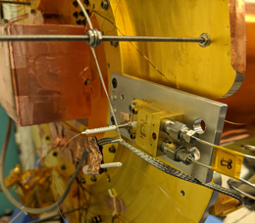
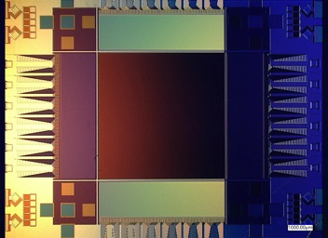
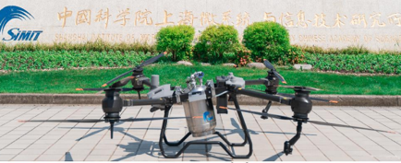
NASA: Superconducting Nanowire Single Photon Detectors
Description: SNSPDs are ultra-low-noise (<10⁻⁵ cps/pixel) detectors for picosecond time-resolved single photon counting from UV – VLWIR wavelengths. Large cameras (400,000 pixels) have recently been demonstrated at low TRL, and single-pixel SNSPDs for quantum communication are TRL-5 for flight.
Details
Current TRL:
  SNSPD arrays are TRL-6 for ground-based NASA Laser Comm Demonstrations
  Single-pixel SNSPDs certified by JPL Mission Assurance to be TRL-5 for flight
  Large-format arrays are TRL 2-3
Organizations Involved:
  JPL, POC: Matt Shaw (SNSPDs)
  NIST, POC: Adam McCaughan (SNSPDs)
  GSFC, POC: Mike Dipirro (Flight Cryogenics)
Underlying/Enabling Technologies:
  Large-format superconducting sensors
  Flight cryogenics
  Flight readout electronics and data processing
  Cryogenic detector instrumentation
Cost & Schedule
Planned Milestones:
  DARPA: Practical MgB2 SNSPD arrays with operating temperature of 15-25 K (FY28)
  NASA: Megapixel UV arrays and single pixel EUV SNSPDs (<100 nm)
  NASA/DOE: Efficient SNSPD arrays at 10-30 µm, proof-of-concept SNSPDs 30 – 120 µm
  JPL: SNSPD arrays for quantum computing with neutral atoms (with Caltech)
  DOE: SNSPDs for quantum networking (with Caltech and Fermilab)
  NIST: MWIR SNSPD arrays for semiconductor failure analysis (CHIPS grand challenge)
Cost and Schedule Risks:
  Existing projects are research tasks with diverse portfolio of risk
Test of SNSPD on Flight ADR at GSFC
Activities & Approach
JPL/Caltech and NIST are collaboratively developing large-format SNSPD arrays for astronomy and quantum computing applications. These arrays are currently low TRL but have high potential for disruptive impact for low-light-level time-resolved imaging from space.
Impact
How does this project improve the SoA and meet Mission/Agency needs?
  SNSPDs are the highest performance sensors available for time-resolved single photon counting from EUV - VLWIR. They have achieved 98% system detection efficiency at 1550 nm, have been scaled to pixel counts as high as 400,000 pixels (in proof-of-concept form), have demonstrated maximum count rates of 10⁷ cps per pixel, zero read noise, dark count rates <10⁻⁵ cps per pixel, and are TRL-5 for flight
Single-pixel SNSPDs have been developed for quantum communication that would enable entanglement distribution on a 10 GHz clock. They are currently TRL-5 for flight, and have been through radiation testing, shake testing, lifetime testing and testing with a flight cryocooler.
An SNSPD instrument at 2K could be built with <100 kg of mass and <300W of power consumption. This would represent the first demonstration of SNSPD technology in flight.
Planned/Potential application(s):
  Astronomy, Remote Sensing, Optical Communication, Biomedical imaging
Does this enable other quantum technologies?
Quantum networks, quantum communication, quantum computing (neutral atoms, trapped ions, and linear optics), quantum imaging
Oripov et al, Nature (2023)
Drone-based SNSPD system, SIMIT (China)

Slide 15
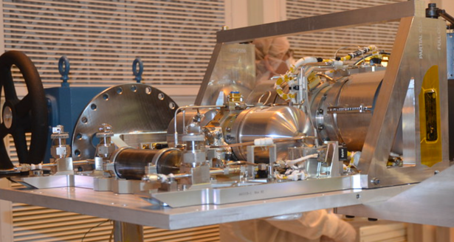
NASA: Flight SNSPD Pathfinder
How could S&T Partnership collaboration benefit this effort?
Collaborative SNSPD flight instrument for quantum communication could provide first demonstration of SNSPD technology in space while enabling world-leading capabilities in space-based entanglement distribution
How does a collaboration here benefit the S&T Partnership?
Establish US leadership of flight SNSPD technology in competition with international agencies, especially with China
Provide world-leading detector capabilities for a space-based quantum networking demonstration at high clock rates
Demonstrate SNSPD technology for future space-based remote sensing and time-resolved single photon imaging applications
CY24 Technical Milestone and 3-5 Year Demonstration
Major tasks required (2024):
Refinement of instrument concept, including flight electronics and flight cryogenics
Advancement of single-pixel SNSPD technology from TRL-5 to TRL-6 for flight
Pulse tube Cryocooler
(Heritage from JWST)
Technologies/facilities needed to advance project to a demo:
  SNSPD technology is sufficiently mature for a flight demo
  Existing facilities at JPL and GSFC (Microdevices Laboratory, Flight cryogenics labs, flight electronics and instrument laboratories) are sufficient to implement an SNSPD demo
Time required to get to a demo:
  Approximately 3-5 years for a flight demonstration
  3 years for instrument delivery (SRR/PDR/CDR/HRCR)
  1-2 years for integration with larger system and launch

Slide 16
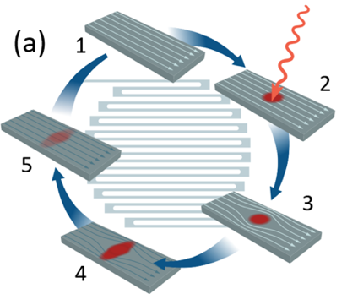
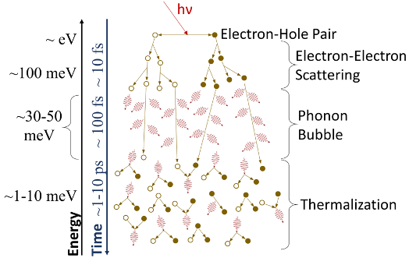
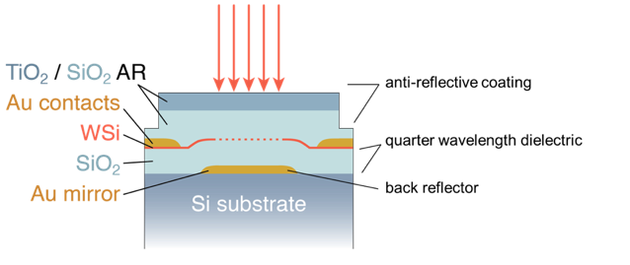
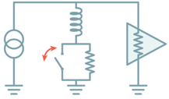
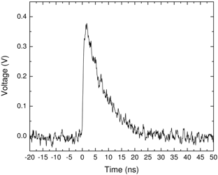
Superconducting Nanowire Single Photon Detectors
Time-resolved single photon counting from UV to mid-IR
Truly digital detection mechanism – reduced drift and zero read noise
No energy resolution
Operating temperature 1-4 K in most cases

Slide 17
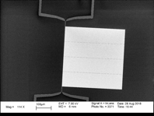
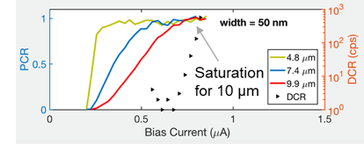
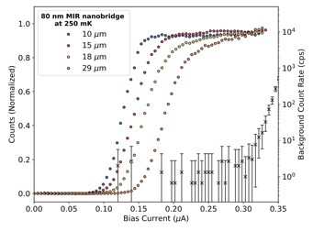
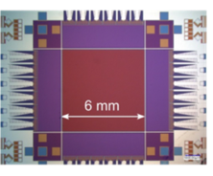
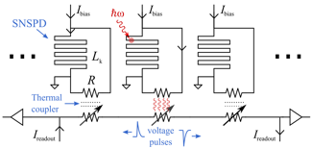
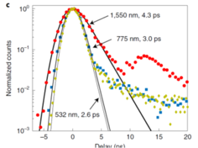
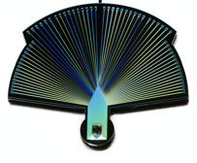
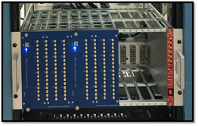
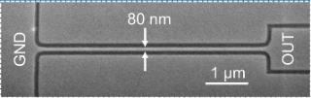
Present State of The Art in SNSPDs
High Efficiency
98% SDE @ 1550 nm (NIST)
Low Dark Counts
6e-6 cps (MIT/NIST)
Chiles et al, Phys. Rev. Lett. (2022)
Reddy et al, Optica (2019)
UV – Mid-IR Operation
Photon counting from 0.1 - 29 µm (JPL/MIT/NIST)
Large Array Formats
400 kpix with time-domain multiplexing (NIST/JPL)
High Time Resolution
2.6 ps FWHM (MIT/JPL/NIST)
High Event Rate
1.5 Gcps in 32-element array (JPL)
Oripov et al, Nature (2023)
Taylor et al, Optica (2023)
Korzh et al, Nature Photonics (2020)
Craiciu et al, Optica (2023)

Slide 18
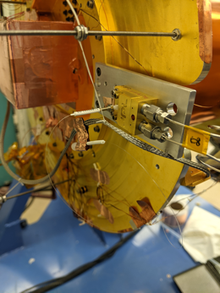
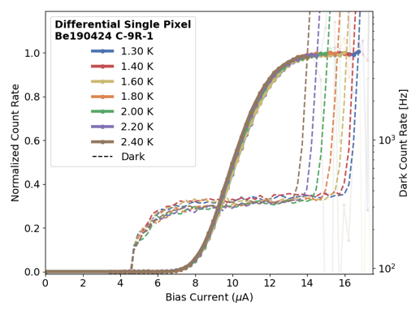
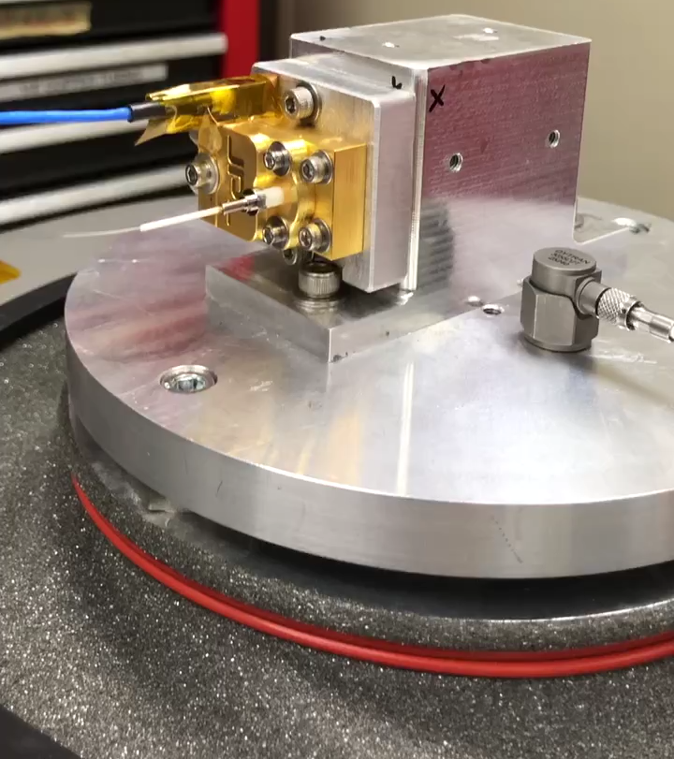
Toward a Space Demonstration
JPL mission assurance has certified SNSPDs as TRL-5 for flight
Performed measurements of SNSPD on flight-like CADR at GSFC
No change in switching current after 200 krad protons
Performed successful shake test of package
Have performed 10x thermal cycles of same device without impact
Currently testing flight-compatible readout ASICs
Tests with flight-like cryogenic system at GSFC

